Slide 1

Data Structures & Algorithms
Week-10

Slide 2
Week-10 Agenda
  Bubble Sort
  Quick Sort
  Merge Sort

Slide 3
Bubble Sort
Bubble sort works on the repeatedly swapping of adjacent elements until they are not in the intended order.
It is called bubble sort because the movement of array elements is just like the movement of air bubbles in the water.
Bubbles in water rise up to the surface; similarly, the array elements in bubble sort move to the end in each iteration.

Slide 4
Bubble Sort
Best Case Complexity - It occurs when there is no sorting required, i.e. the array is already sorted. The best-case time complexity of bubble sort is O(n).
Average Case Complexity - It occurs when the array elements are in jumbled order that is not properly ascending and not properly descending. The average case time complexity of bubble sort is O(n²).
Worst Case Complexity - It occurs when the array elements are required to be sorted in reverse order. That means suppose you have to sort the array elements in ascending order, but its elements are in descending order. The worst-case time complexity of bubble sort is O(n²).

Slide 5
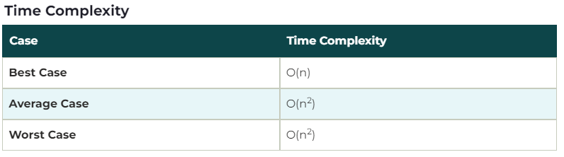
Bubble Sort

Slide 6
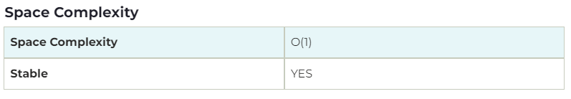
Bubble Sort
The space complexity of bubble sort is O(1). It is because, in bubble sort, an extra variable is required for swapping.
The space complexity of optimized bubble sort is O(2). It is because two extra variables are required in optimized bubble sort.

Slide 7
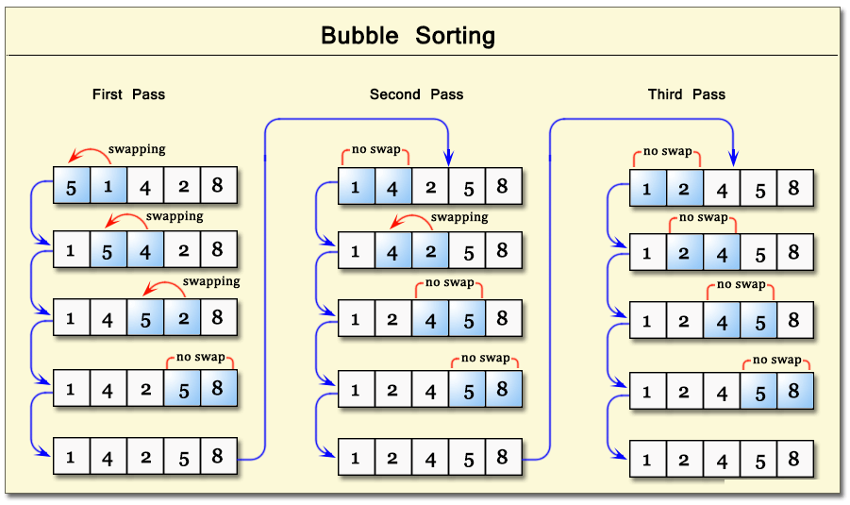
Bubble Sort - Working

Slide 8
Quick Sort
  Quicksort is the widely used sorting algorithm that makes n log n comparisons in average case for sorting an array of n elements.
  It is a faster and highly efficient sorting algorithm. This algorithm follows the divide and conquer approach.
  Divide and conquer is a technique of breaking down the algorithms into subproblems, then solving the subproblems, and combining the results back together to solve the original problem.

Slide 9
Quick Sort
Divide: In Divide, first pick a pivot element.
After that, partition or rearrange the array into two sub-arrays such that each element in the left sub-array is less than or equal to the pivot element and each element in the right sub-array is larger than the pivot element.
Conquer: Recursively, sort two subarrays with Quicksort.
Combine: Combine the already sorted array.

Slide 10
Quick Sort - Working
Quicksort picks an element as pivot, and then it partitions the given array around the picked pivot element.
In quick sort, a large array is divided into two arrays in which one holds values that are smaller than the specified value (Pivot), and another array holds the values that are greater than the pivot.
After that, left and right sub-arrays are also partitioned using the same approach.
It will continue until the single element remains in the sub-array.

Slide 11
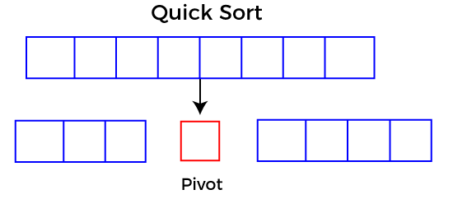
Quick Sort - Working

Slide 12
Quick Sort - Working
Choosing the pivot
Picking a good pivot is necessary for the fast implementation of quicksort.
However, it is typical to determine a good pivot.
Some of the ways of choosing a pivot are as follows:
  Pivot can be random, i.e. select the random pivot from the given array.
  Pivot can either be the rightmost element of the leftmost element of the given array.
  Select median as the pivot element.

Slide 13

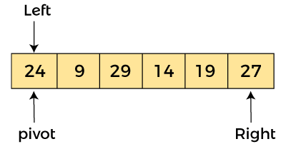
Quick Sort - Working
Let the elements of array are:
In the given array, we consider the leftmost element as pivot. So, in this case, a[left] = 24, a[right] = 27 and a[pivot] = 24.
Since, pivot is at left, so algorithm starts from right and move towards left.

Slide 14
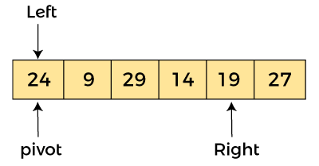
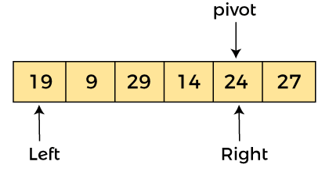
Quick Sort - Working
Now, a[pivot] < a[right], so the algorithm moves forward one position towards left, i.e.
Now, a[left] = 24, a[right] = 19, and a[pivot] = 24.
Because, a[pivot] > a[right], so, algorithm will swap a[pivot] with a[right], and pivot moves to right, as:

Slide 15
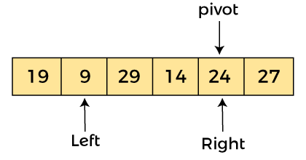
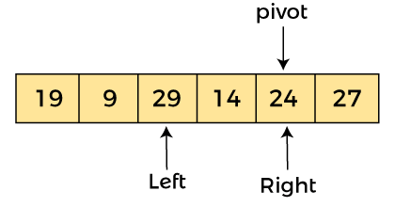
Quick Sort - Working
Now, a[left] = 19, a[right] = 24, and a[pivot] = 24. Since, pivot is at right, so algorithm starts from left and moves to right.
As a[pivot] > a[left], so algorithm moves one position to right as:
Now, a[left] = 9, a[right] = 24, and a[pivot] = 24. As a[pivot] > a[left], so algorithm moves one position to right as:

Slide 16
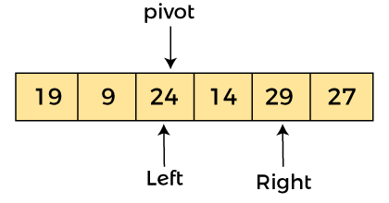
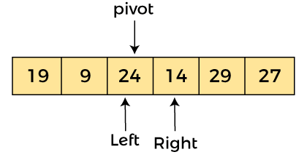
Quick Sort - Working
Now, a[left] = 29, a[right] = 24, and a[pivot] = 24. As a[pivot] < a[left], so, swap a[pivot] and a[left], now pivot is at left, i.e:
Since, pivot is at left, so algorithm starts from right, and move to left. Now, a[left] = 24, a[right] = 29, and a[pivot] = 24. As a[pivot] < a[right], so algorithm moves one position to left, as:

Slide 17
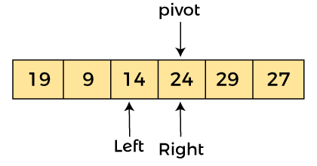
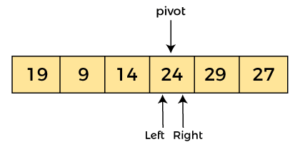
Quick Sort - Working
Now, a[pivot] = 24, a[left] = 24, and a[right] = 14. As a[pivot] > a[right], so, swap a[pivot] and a[right], now pivot is at right, i.e.
Now, a[pivot] = 24, a[left] = 14, and a[right] = 24. Pivot is at right, so the algorithm starts from left and move to right.

Slide 18
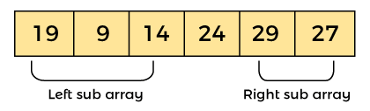

Quick Sort - Working
Now, a[pivot] = 24, a[left] = 24, and a[right] = 24. So, pivot, left and right are pointing the same element. It represents the termination of procedure.
Element 24, which is the pivot element is placed at its exact position.
Elements that are right side of element 24 are greater than it, and the elements that are left side of element 24 are smaller than it.
Now, in a similar manner, quick sort algorithm is separately applied to the left and right sub-arrays. After sorting gets done, the array will be:

Slide 19
Quick Sort Complexity
Best Case Complexity - In Quicksort, the best-case occurs when the pivot element is the middle element or near to the middle element. The best-case time complexity of quicksort is O(n*logn).
Average Case Complexity - It occurs when the array elements are in jumbled order that is not properly ascending and not properly descending. The average case time complexity of quicksort is O(n*logn).
Worst Case Complexity - In quick sort, worst case occurs when the pivot element is either greatest or smallest element. Suppose, if the pivot element is always the last element of the array, the worst case would occur when the given array is sorted already in ascending or descending order. The worst-case time complexity of quicksort is O(n²).

Slide 20
Quick Sort Complexity
The space complexity of quicksort is O(n*logn).

Slide 21
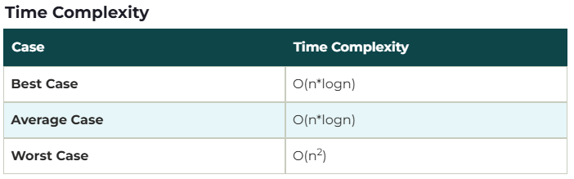
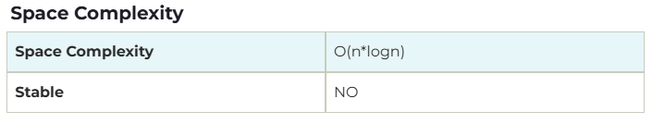
Quick Sort Complexity

Slide 22
Merge Sort
There are 3 Phases (4 major steps) in the Merge Sort Algorithm –
Division Phase – Divide the array(list) into 2 halves by finding the midpoint of the array(list).
  Midpoint (m) = (left + right)/ 2
  Here left is the starting index & right is the last index of the array(list)
Recursion Phase –
  Call Merge Sort on the left sub-array (sub-list)
  Call Merge Sort on the right sub-array (sub-list)
Merge Phase –
  Call the merge function to merge the divided sub-arrays back to the original array.
  Perform sorting of these smaller sub-arrays before merging them back.

Slide 23
Merge Sort
There are 3 Phases (4 major steps) in the Merge Sort Algorithm –
Division Phase – Divide the array(list) into 2 halves by finding the midpoint of the array(list).
  Midpoint (m) = (left + right)/ 2
  Here left is the starting index & right is the last index of the array(list)
Recursion Phase – Call Merge Sort on the left sub-array (sub-list)
  Call Merge Sort on the right sub-array (sub-list)
Merge Phase – Call merge function to merge the divided sub-arrays back to the original array.
  Perform sorting of these smaller sub-arrays before merging them back.

Slide 24
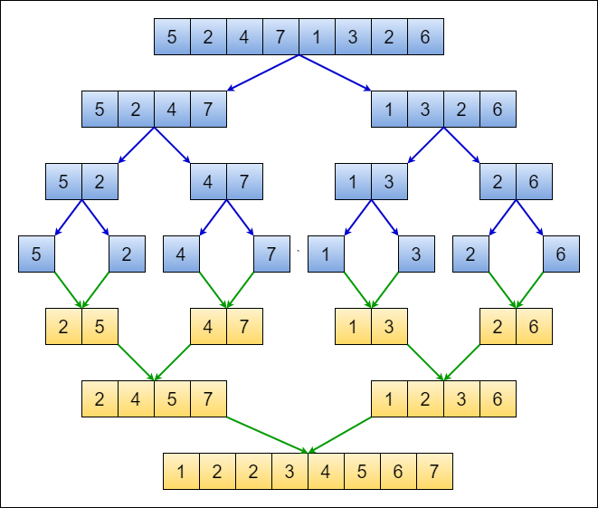
Merge Sort

Slide 25
Merge Sort Complexity
Best Case Complexity - It occurs when there is no sorting required, i.e. the array is already sorted. The best-case time complexity of merge sort is O(n*logn).
Average Case Complexity - It occurs when the array elements are in jumbled order that is not properly ascending and not properly descending. The average case time complexity of merge sort is O(n*logn).
Worst Case Complexity - It occurs when the array elements are required to be sorted in reverse order. That means suppose you have to sort the array elements in ascending order, but its elements are in descending order. The worst-case time complexity of merge sort is O(n*logn).

Slide 26
Merge Sort Complexity
The space complexity of merge sort is O(n). It is because, in merge sort, an extra variable is required for swapping.

Slide 27
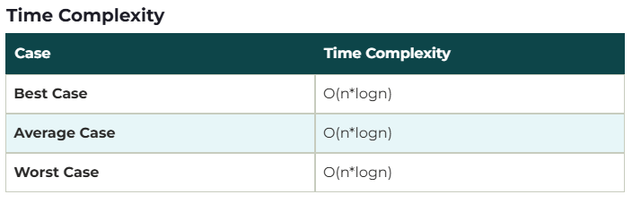
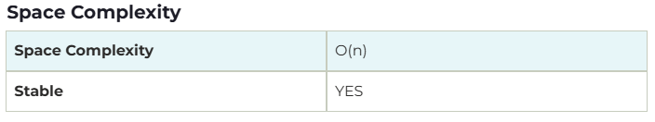
Merge Sort Complexity

Slide 28


